Slide 1
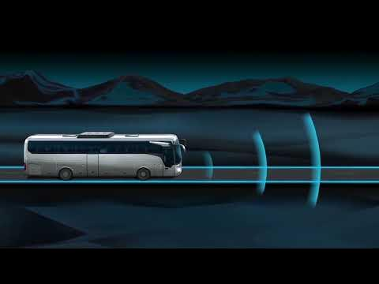
SafeTravels -
Online Bus Booking System
Presented by:-
SYED MADIHA BANU

Slide 2
INTRODUCTION
Safe Travels is a web-based bus ticket booking platform.
It allows users to:- Book bus tickets online View available buses with details Select seats interactively Make payments securely It provides a real-time and user-friendly booking experience.

Slide 3
⚙️ Working of the Website
Step 1: User opens the homepage and sees a moving bus animation.
Step 2: Clicks “Book a Seat” to enter details (Name, From, To, Mobile, Date).
Step 3: System displays available buses with operator, type, time, price, and image.
Step 4: User selects a bus → Seat layout appears. Step 5: User selects a seat and clicks “Proceed to Payment.”
Step 6: User selects payment method (PhonePe, Paytm, Gpay).
Step 7: Confirmation screen shows ticket details.

Slide 4
🎯Uses of the Website
Helps users book bus tickets easily without standing in queues. Works as a real-time travel planner. Users can compare bus types and prices. Saves time by allowing seat selection in advance. Supports digital payments for a cashless experience.

Slide 5
✅ Advantages:
🚌 User-Friendly Interface 📱 Mobile Responsive Design 🎥 Realistic UI with animations and seat layout 🔒 Secure Payment Simulation ⚡ Quick Booking Flow 💰 Transparent Pricing Display

Slide 6
⚠️ Disadvantages:
Currently limited to predefined routes No real payment gateway (simulation only) Static data; not connected to a real-time database

Slide 7
🔭 Future Scope:
✅ Connect to live bus APIs for real-time availability and bookings. ✅ Enable real payment gateway integration (Razorpay, Paytm, etc.). ✅ Convert to a full-stack application using Node.js, MongoDB, etc.

Slide 8
🎉 Conclusion:
SafeTravels is a complete frontend project that gives a realistic experience of bus booking. With a simple design and useful features, it’s a good base for future development.

Slide 9
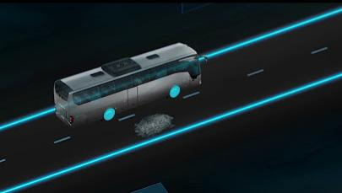
Thank you for watching 👀...

